Slide 1
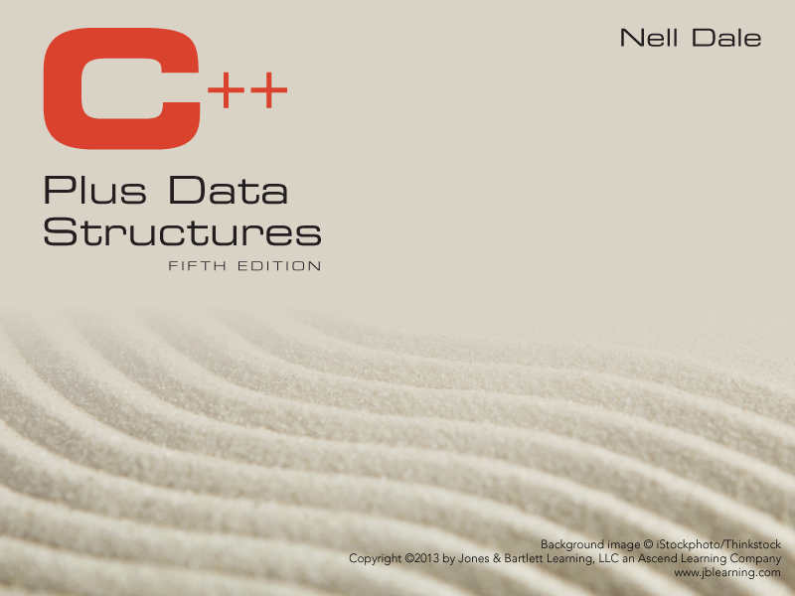
Chapter 2
Data Design and Implementation

Slide 2
Data
The representation of information in a manner suitable for communication or analysis by humans or machines

Slide 3
Data Abstraction
Separation of a data type’s logical properties from its implementation
LOGICAL PROPERTIES IMPLEMENTATION
What are the possible values? How can this be done in C++?
What operations will be
needed? How can data types be used?

Slide 4
Data Encapsulation
is the separation of the representation of data from the applications that use the data at a logical level;
  a programming language feature that enforces information hiding
APPLICATION
REPRESENTATION
int y;
y = 25;
0 0 0 0 0 0 0 0 0 0 0 1 1 0 0 1

Slide 5
Encapsulated C++ Data Type int
TYPE
int
Value range:
INT_MIN . . INT_MAX
Operations:
+ prefix
- prefix
+ infix
- infix
* infix
/ infix
% infix
Relational Operators
infix
Representation of
int
as 16 bits two’s
complement
+
Implementation of
Operations
(inside)

Slide 6
Abstract Data Type (ADT)
A data type whose properties (domain and operations) are specified independently of any particular implementation.

Slide 7
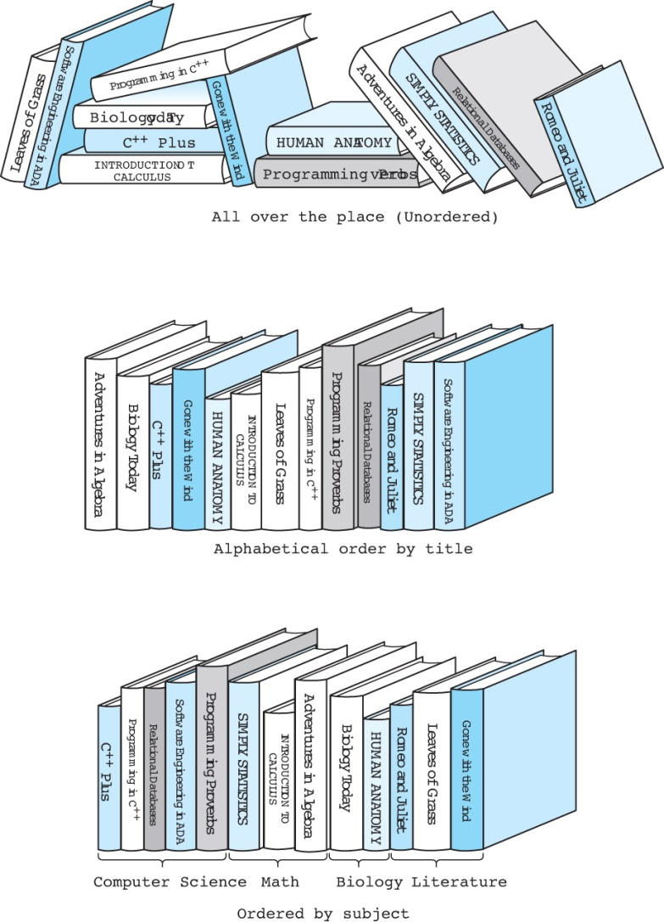
Collection ordered in different ways

Slide 8
Data from 3 different levels
Application (or user) level: modeling real-life data in a specific context.
Logical (or ADT) level: abstract view of the domain and operations. WHAT
Implementation level: specific representation of the structure to hold the data items, and the coding for operations. HOW

Slide 9


Communication between the Application Level and Implementation Level

Slide 10
Viewing a library from 3 different levels
Application (or user) level: Public library, or NSU library
Logical (or ADT) level: domain is a collection of books;
  operations include: check book out, check book in, pay fine, reserve a book.
Implementation level: representation of the structure to hold the “books”, and the coding for operations.

Slide 11
C++ Built-In Data Types
Simple
Composite
Integral
Floating
array struct union class
char short int long enum
Address
float double long double
pointer reference

Slide 12
Composite Data Type
A composite data type is a type which
stores a collection of individual data components under one variable name,
and allows the individual data components to be accessed.

Slide 13
Two Forms of Composite Data Types
UNSTRUCTURED
STRUCTURED
Components are not
organized with respect to
one another.
The organization
determines method used
to access individual
data components.
EXAMPLES: EXAMPLES: arrays
classes and structs

Slide 14
Records
A record is a composite data type made up of a finite collection of not necessarily homogeneous elements called members or fields.
For example . . .
thisCar at Base Address 6000
.year 2008
.maker ‘h’‘o’‘n’‘d’ ‘a’‘\0’ . . .
.price 18678.92

Slide 15
struct CarType
struct CarType
{
int year;
char maker[10];
float price;
} ;
CarType thisCar; //CarType variables
CarType myCar;

Slide 16
Accessing struct members
The member selection operator (period . ) is used between the variable name and the member identifier to access individual members of a record (struct or class) type variable.
EXAMPLES
myCar.year
thisCar.maker[4]

Slide 17
One-Dimensional Array at the Logical Level
A one-dimensional array is a structured composite data type made up of
a finite,
fixed size (known at compile time)
collection of homogeneous (all of the same data type) elements
having relative positions and
to which there is direct access (any element can be accessed immediately).
Array operations (creation, storing a value, retrieving a value) are performed using a declaration and indexes.

Slide 18
Implementation Example
This ACCESSING FUNCTION gives position of values[Index]
Address(Index) = BaseAddress + Index * SizeOfElement
float values[5]; // assume element size is 4 bytes
Base Address
7000 7004 7008 7012 7016
values[0] values[1] values[2] values[3] values[4]
Indexes

Slide 19
One-Dimensional Arrays in C++
The index must be of an integral type
The index range is always 0 through the array size minus 1

Slide 20
Another Example
char name[10]; // assume element size is 1 byte
This ACCESSING FUNCTION gives position of name[Index]
Address(Index) = BaseAddress + Index * SizeOfElement
Base Address
6000 6001 6002 6003 6004 6005 6006 6007 6008 6009
name[0] name[1] name[2] name[3] name[4] . . . . . name[9]

Slide 21
Passing Arrays as Parameters
In C++, arrays are always passed by reference,
  and & is not used with the formal parameter type.
Whenever an array is passed as a parameter, its base address is sent to the called function.

Slide 22
const array parameter
Because arrays are always passed as reference parameters, you can protect the actual parameter from unintentional changes by using const in formal parameter list and function prototype.
FOR EXAMPLE . . .
// prototype
float SumValues( const float values[ ],
int numOfValues );

Slide 23
float SumValues (const float values[ ], numOfValues)
// Pre: values[ 0] through values[numOfValues-1]
// have been assigned
// Returns the sum of values[0] through
// values[numOfValues-1]
{
float sum = 0;
for ( int index = 0; index < numOfValues;
index++ )
{
sum = values [index] + sum;
}
return sum;
}

Slide 24
Two-Dimensional Array at the Logical Level
A two-dimensional array is a structured composite data type made up of a finite, fixed size collection of homogeneous elements having relative positions and to which there is direct access.
Array operations (creation, storing a value, retrieving a value) are performed using a declaration and a pair of indexes (called row and column) representing the component’s position in each dimension.

Slide 25
EXAMPLE -- To keep monthly high temperatures for 50 states in a two-dimensional array.
const int NUM_STATES = 50 ;
const int NUM_MONTHS = 12 ;
int stateHighs [ NUM_STATES ] [ NUM_MONTHS ] ;
[ 0 ]
[ 1 ]
[ 2 ]
.
. stateHighs [2] [7]
.
[ 48 ]
[ 49 ]
[0] [1] [2] [3] [4] [5] [6] [7] [8] [9] [10] [11]
row 2,
col 7
might be
Arizona’s
high for
August
66 64 72 78 85 90 99 115 98 90 88 80

Slide 26
Finding the average high temperature for Arizona
float total = 0;
int month;
float average;
for ( month = 0; month < NUM_MONTHS;
month ++ )
total = total + stateHighs [ 2 ][ month ];
average = ( total / NUM_MONTHS);

Slide 27
const int NUM_STATES = 50 ; const int NUM_MONTHS = 12 ; int stateHighs [ NUM_STATES ] [ NUM_MONTHS ] ;
STORAGE
rows columns
In memory, C++ stores arrays in row order. The first row is followed by the second row, etc.
Base Address
8000
8024
8048
. . .
12 highs for state 0 12 highs for state 1 etc.
Alabama Alaska
first row second row

Slide 28
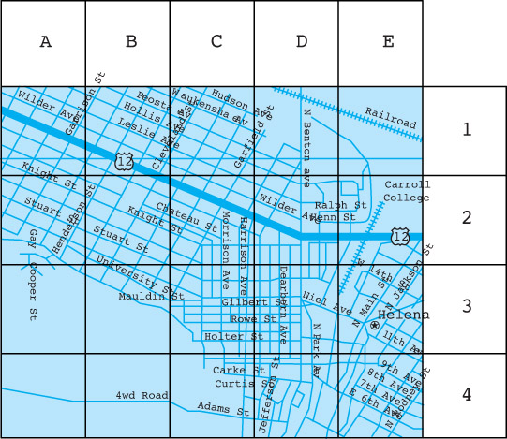
Example of a 2-dimensional object

Slide 29
C++ class data type
A class is an unstructured type that encapsulates a fixed number of
data components (data members) with the
functions (called member functions) that manipulate them.

Slide 30
class DateType Specification
// SPECIFICATION FILE ( datetype.h )
class DateType // declares a class data type
{
public :
// 4 public member functions
void Initialize (int newMonth, int newDay, int newYear ) ;
int GetYear( ) const ; // returns year
int GetMonth( ) const ; // returns month
int GetDay( ) const ; // returns day
private :
// 3 private data members
int year ;
int month ;
int day ;
};
; must be there!!!

Slide 31
Use of C++ data type class
Variables of a class type are called objects (or instances) of that particular class.
Software that declares and uses objects of the class is called a client.
Client code uses public member functions (called methods in OOP) to handle its class objects.
. means calling a public member function.

Slide 32
Client Code Using DateType
#include “datetype.h” // includes specification of the class
using namespace std;
int main ( void )
{
DateType startDate; // declares 2 objects of DateType
DateType endDate;
bool retired = false;
startDate.Initialize ( 6, 30, 1998 );
endDate.Initialize ( 10, 31, 2002 );
cout << startDate.MonthIs( ) << “/” << startDate.DayIs( )
<< “/” << startDate.YearIs( ) << endl;
while ( ! retired )
{
// finishSomeTask
}
}

Slide 33
2 separate files generally used for class type
// SPECIFICATION FILE ( datetype .h )
// Specifies the data and function members.
class DateType
{
public:
. . .
private:
. . .
} ;
// IMPLEMENTATION FILE ( datetype.cpp )
// Implements the DateType member functions.
. . .

Slide 34
DateType Class Instance Diagrams
startDate endDate
Private data:
year
month
day
Private data:
year
month
day
Initialize
Initialize
1998
6
30
2002
10
31
GetYear
GeytYear
GetMonth
GetMonth
GetDay
GetDay

Slide 35
Implementation of DateType member functions
// IMPLEMENTATION FILE (datetype.cpp)
#include “datetype.h” // also must appear in client code
void DateType :: Initialize ( int newMonth,
int newDay,
int newYear )
// Post: year is set to newYear.
// month is set to newMonth.
// day is set to newDay.
{
year = newYear;
month = newMonth;
day = newDay;
}

Slide 36
int DateType :: GetMonth ( ) const
// Accessor function for data member month
{
return month;
}
int DateType :: GetYear ( ) const
// Accessor function for data member year
{
return year;
}
int DateType :: GetDay ( ) const
// Accessor function for data member day
{
return day;
}

Slide 37
Scope Resolution Operator ( :: )
C++ programs typically use several class types.
Different classes can have member functions with the same identifer, like Write( ).
Member selection operator is used to determine the class whose member function Write( ) is invoked.
currentDate.Write( ) ; // class DateType
numberZ.Write( ) ; // class ComplexNumberType
In the implementation file, the scope resolution operator is used in the heading before the member function’s name to specify its class.
void DateType :: Write ( ) const
{ . . .
}

Slide 38
Order of Magnitude of a Function
The order of magnitude, or Big-O notation,
of a function expresses the computing time
of a problem as the term in a function that
increases most rapidly relative to the size
of a problem.

Slide 39
Complexity
Let us assume two algorithms A and B that solve the same class of problems.
The time complexity of A is 5,000n, the one for B is ⎡1.1^{n}⎤ for an input with n elements.
For n = 10,
  A requires 50,000 steps,
  but B only 3,
  so B seems to be superior to A.
For n = 1000, A requires 5,000,000 steps,
  while B requires 2.5⋅10⁴¹ steps.

Slide 40
Complexity
This means that algorithm B cannot be used for large inputs, while algorithm A is still feasible.
So what is important is the growth of the complexity functions.
The growth of time and space complexity with increasing input size n is a suitable measure for the comparison of algorithms.

Slide 41
Names of Orders of Magnitude
O(1) bounded (by a constant) time
O(log₂N) logarithmic time
O(N) linear time
O(N*log₂N) N*log₂N time
O(N²) quadratic time
O(N³) cubic time
O(2^{N} ) exponential time

Slide 42
N log₂N N*log₂N N² 2^{N}
1 0 0 1 2
2 1 2 4 4
4 2 8 16 16
8 3 24 64 256
16 4 64 256 65,536
32 5 160 1024 4,294,967,296
64 6 384 4096 1.84*10¹⁹
128 7 896 16,384 3.40*10³⁸

Slide 43
The Growth of Functions
“Popular” functions g(n) are
n log n, log n, 1, 2^{n}, n², n!, n, n³
Listed from slowest to fastest growth:
1
log n
n
n log n
n²
n³
2^{n}
n!

Slide 44
The Growth of Functions
A problem that can be solved with polynomial worst-case complexity is called tractable
Problems of higher complexity are called intractable
Problems that no algorithm can solve are called unsolvable

Slide 45
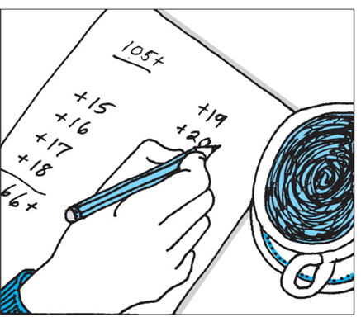

Comparison of Two Algorithms
Add all numbers from 1 to 20

Slide 46
Complexity Examples
What does the following algorithm compute?
int who_knows(int a[n]) {
int m = 0;
for {int i = 0; i<n; i++}
for {int j = i+1; j<n; j++}
if ( abs(a[i] – a[j]) > m )
m = abs(a[i] – a[j]);
return m;
}
returns the maximum difference between any two numbers in the input array
Time complexity is O(n²)

Slide 47
Complexity Examples
Another algorithm solving the same problem:
int max_diff(int a[n]) {
int min = a[0];
int max = a[0];
for {int i = 1; i<n; i++}
if ( a[i] < min )
min = a[i];
else if ( a[i] > max )
max = a[i];
return max-min;
}
Time complexity is O(n).

Slide 48
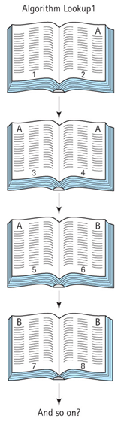
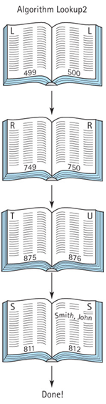
Find “John Smith”

